Slide 1
Big things have small beginnings.
Michael Humphrey & Brian Ferry

Slide 2
Regular expressions significantly improve performance
24 class State:
25 def __init__(self, prev, turn):
26 self.prev = prev
27 self.turn = turn
28
29 def __hash__(self):
30 return hash((self.prev, self.turn))
31
32 def __eq__(self, other):
33 return (self.prev == other.prev) and (self.turn == other.turn)
34
35 def __repr__(self):
36 return str(self)
37
38 def __str__(self):
39 return "State(prev='{}')".format(self.prev)
40
41 """Return whether this state is a terminal state (i.e. spells a word)"""
42 def is_terminal(self):
43 return bool(re.search("\n{}\n".format(self.prev), words))
44
45 """Return all valid successors of this state"""
46 def successors(self):
47 return list(set([State(self.prev + match[len(self.prev)+1], (self.turn+1)%2) for match in re.findall("\n{}..*\n".format(self.prev), words)]))
48

Slide 3
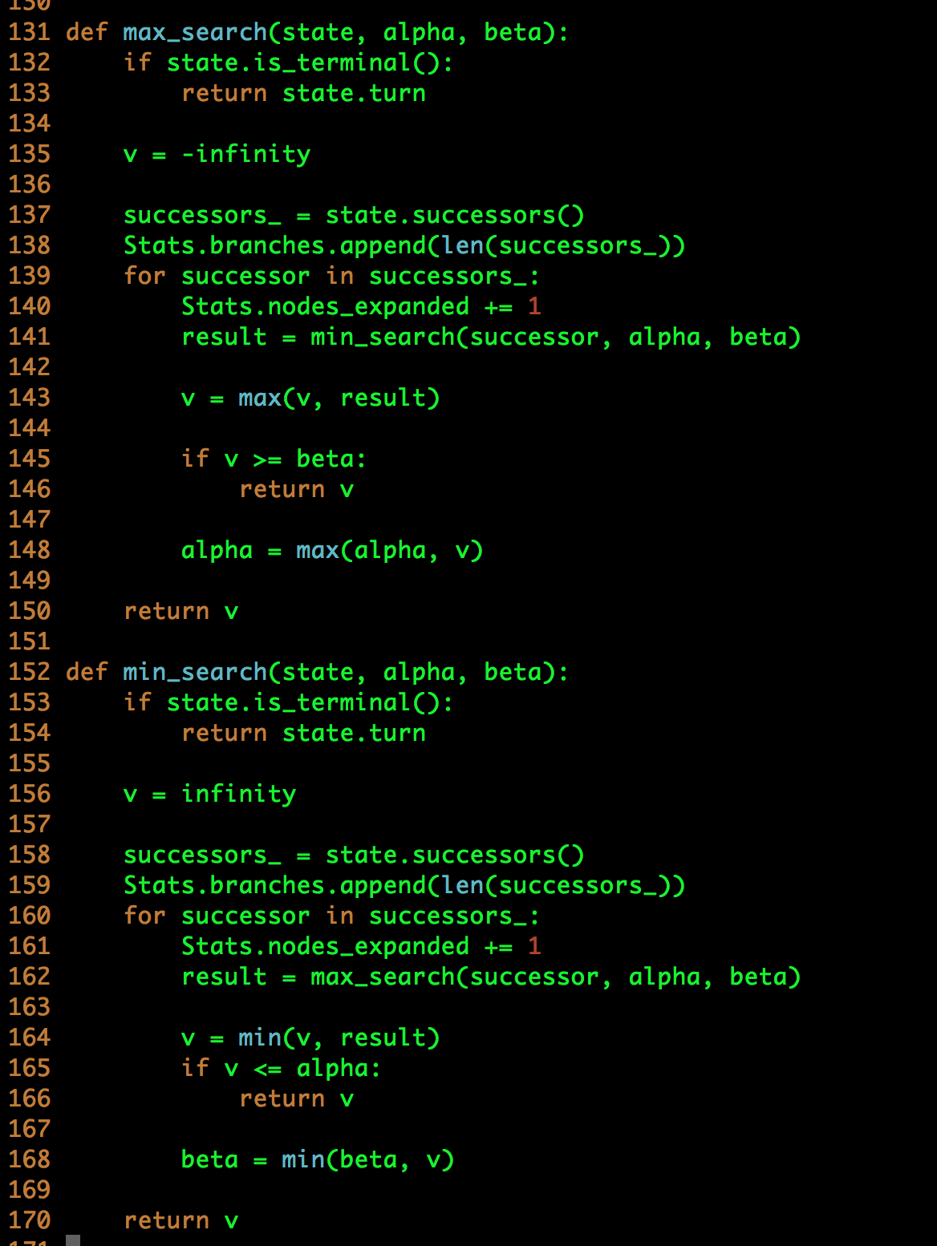
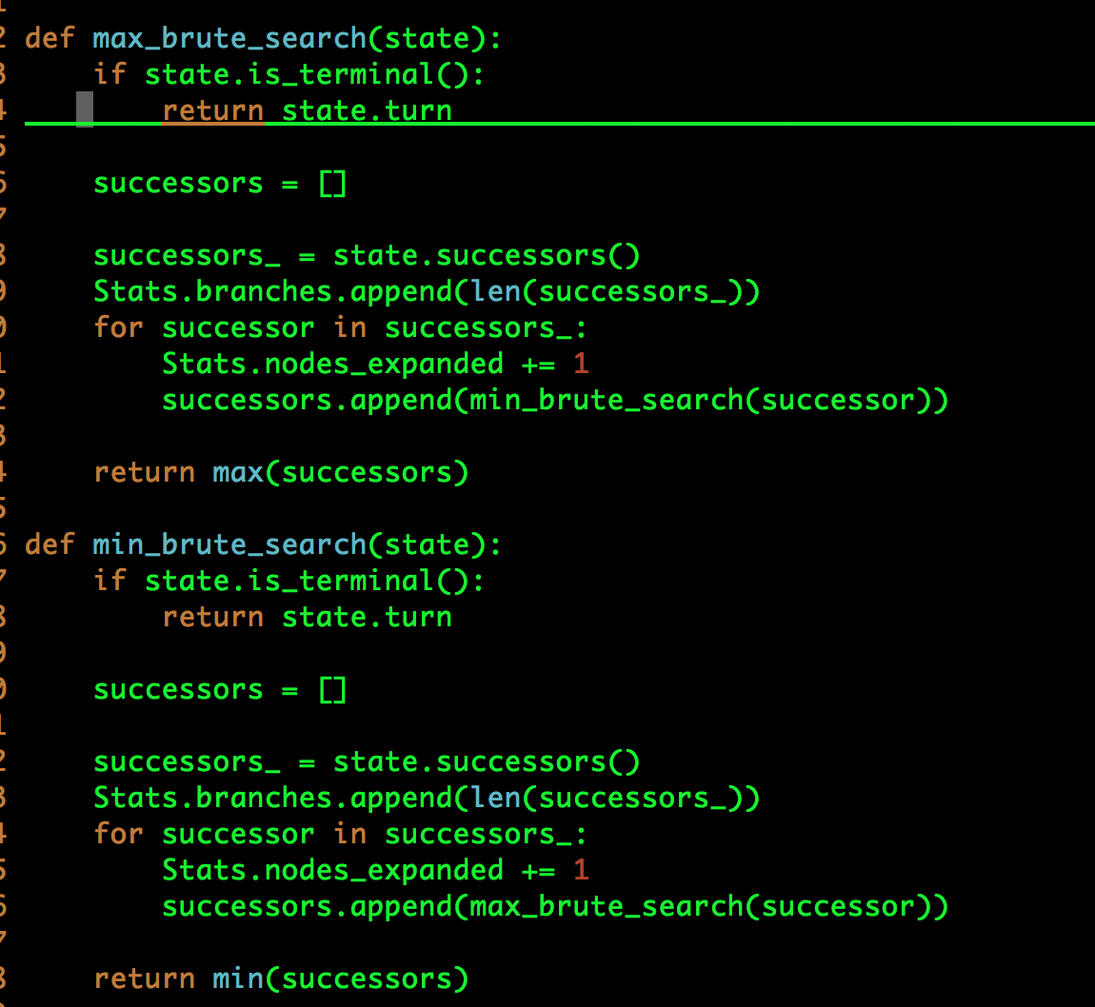

Slide 4
B16MBP:ghost brianferry$ python3 main.py words_alpha.txt
[State(prev='x'), State(prev='i'), State(prev='b'), State(prev='d'), State(prev='h'), State(prev='a'), State(prev='z'), State(prev='o'), State(prev='n'), State(prev='r'), State(prev='f'), State(prev='s'), State(prev='j'), State(prev='y'), State(prev='t'), State(prev='w'), State(prev='m'), State(prev='g'), State(prev='l'), State(prev='q'), State(prev='u'), State(prev='c'), State(prev='e'), State(prev='k'), State(prev='p'), State(prev='v')]
Computer's move. Current letters are
Computer playing letter 'a'
Player 2's move. Current letters are: a
Player 2 playing letter 'u'
Computer's move. Current letters are au
Computer playing letter 'r'
Player 2's move. Current letters are: aur
Player 2 playing letter 'o'
Computer's move. Current letters are auro
Computer playing letter 't'
Player 2's move. Current letters are: aurot
Player 2 playing letter 'e'
Computer's move. Current letters are aurote
Computer playing letter 'l'
Player 2's move. Current letters are: aurotel
Player 2 playing letter 'l'
Computer's move. Current letters are aurotell
Computer playing letter 'u'
Player 2's move. Current letters are: aurotellu
Player 2 playing letter 'r'
Computer's move. Current letters are aurotellur
Computer playing letter 'i'
Player 2's move. Current letters are: aurotelluri
Player 2 playing letter 't'
Computer's move. Current letters are aurotellurit
Computer playing letter 'e'
Game over
Your opponent spelled 'aurotellurite'. You win!
Stats:
Total nodes expanded: 480
Time for each minimax run: [1.1751689910888672, 0.5887598991394043, 0.08750486373901367, 0.08154702186584473, 0.01749897003173828, 0.017360925674438477, 0.006549835205078125]
[26, 26, 5, 2, 1, 1, 2, 16, 26, 5, 2, 1, 1, 2, 1, 2, 1, 1, 1, 1, 1, 4, 1, 4, 1, 1, 16, 7, 6, 1, 1, 2, 1, 1, 1, 1, 1, 1, 1, 1, 1, 1, 1, 1, 1, 1, 3, 2, 1, 1, 1, 1, 1, 7, 1, 1, 1, 1, 3, 1, 1, 1, 4, 2, 2, 1, 1, 2, 5, 16, 7, 6, 1, 1, 2, 1, 1, 1, 1, 1, 1, 1, 1, 1, 1, 1, 1, 1, 1, 3, 2, 1, 1, 1, 1, 1, 1, 1, 1, 1, 1, 7, 1, 3, 1, 1, 1, 10, 1, 1, 1, 1, 1, 7, 2, 1, 3, 1, 1, 1, 1, 1, 2, 1, 1, 1, 1, 3, 1, 1, 1, 1, 1, 1, 1, 1, 1, 1, 4, 2, 2, 1, 1, 1, 1, 2, 2, 1, 2, 1, 1, 1, 5, 1, 1, 1, 1, 2, 1, 1, 1, 3, 1, 2, 1, 1, 1, 7, 6, 1, 1, 2, 1, 1, 1, 1, 1, 1, 1, 1, 1, 1, 1, 1, 1, 1, 3, 2, 1, 1, 1, 1, 1, 1, 1, 1, 1, 1, 7, 1, 1, 2, 1, 4, 1, 1, 1, 1, 1, 1, 1, 1, 2, 1, 3, 1, 1, 1, 1, 10, 1, 1, 1, 1, 1, 3, 2, 2, 1, 1, 1, 1, 1, 1, 1, 1, 1, 1, 1, 1, 1, 1, 1, 1, 1, 1, 1, 1, 1, 1, 4, 2, 1, 6, 1, 2, 1, 3, 2, 1, 2, 1, 1, 1, 1, 1, 1, 1, 1, 1, 1, 1, 1, 1, 1, 1, 1, 1, 1, 1, 1, 1, 1, 1, 1, 1, 1, 1, 1, 1, 1, 1, 1, 1, 1, 1, 1, 1, 1, 1, 1, 1]
Maximum branching factor: 26
Average branching factor: 1.9503311258278146
Cache hit ratio: 0.04790419161676647

Slide 5
odyssey.txt
1 ======================== Pruning
2 Stats:
3 Total nodes expanded: 423
4 Time for each minimax run: [0.3637197017669678, 0.0040662288665771484, 0.0019099712371826172]
5 [24, 4, 1, 1, 1, 2, 1, 1, 1, 1, 4, 2, 1, 2, 1, 1, 1, 1, 1, 1, 1, 1, 1, 1, 1, 1, 1, 1, 3, 1, 1, 1, 1, 1, 1, 1, 1, 1, 1, 1, 1, 1, 1, 2, 1, 1, 6, 1, 1, 1, 1, 1, 1, 1, 1, 1, 1, 1, 1, 4, 2, 2, 1, 2, 1, 1, 1, 1, 5, 1, 1, 2, 1, 1, 6, 1, 1, 1, 1, 2, 3, 1, 1, 1, 1, 3, 1, 1, 1, 1, 1, 1, 1, 2, 1, 1, 1, 1, 2, 1, 1, 1, 2, 1, 1, 1, 1, 1, 1, 1, 1, 1, 1, 1, 4, 1, 1, 1, 1, 1, 1, 1, 1, 1, 1, 9, 1, 4, 3, 1, 2, 2, 1, 1, 1, 1, 1, 1, 1, 3, 1, 1, 1, 1, 1, 1, 1, 1, 1, 1, 2, 1, 1, 1 , 1, 1, 1, 3, 1, 1, 1, 1, 1, 1, 1, 1, 1, 1, 1, 1, 1, 1, 1, 1, 1, 1, 1, 2, 1, 1, 1, 2, 1, 1, 1, 3, 3, 1, 1, 1, 1, 1, 1, 1, 1, 2, 1, 1, 5, 3, 1, 1, 1, 1, 1, 2, 2, 1, 1, 1, 1, 1, 1, 1, 1, 1, 1, 1, 1, 2, 1, 1, 1, 1, 1, 1, 2, 1, 1, 1, 1, 1, 1, 2, 1, 1, 1, 1, 1, 1, 1, 1, 1, 1, 1, 8, 2, 1, 1, 1, 1, 1, 1, 1, 1, 2, 1, 1, 1, 1, 1, 1, 1, 1, 1, 1, 1, 1, 3, 1, 3, 1, 1, 1, 2, 3, 2, 1, 1, 1, 1, 1, 1, 1, 1, 1, 3, 1, 1, 1, 1, 1, 1, 1, 1, 1, 1, 4, 1, 1, 1, 1, 1, 1, 1, 2, 1, 2 , 1, 1, 1, 1, 1, 1, 1, 2, 1, 1, 1, 1, 1, 1, 1]
6 Maximum branching factor: 24
7 Average branching factor: 1.4024767801857585
8
9 ======================== Brute force
10 Stats:
11 Total nodes expanded: 572
12 Time for each minimax run: [0.48952651023864746, 0.004511117935180664, 0.0021011829376220703]
13 [24, 2, 1, 1, 4, 2, 1, 1, 1, 1, 1, 1, 1, 1, 1, 1, 1, 6, 2, 1, 1, 1, 1, 1, 1, 1, 1, 1, 3, 2, 1, 1, 1, 1, 1, 3, 2, 2, 1, 1, 1, 1, 1, 1, 1, 1, 1, 2, 3, 1, 1, 1, 1, 2, 1, 1, 1, 1, 1, 1, 1, 5, 1, 1, 6, 1, 1, 1, 1, 1, 1, 1, 1, 1, 1, 1, 1, 5, 1, 1, 1, 2, 1, 1, 1, 1, 1, 1, 2, 1, 1, 1, 1, 1, 1, 3, 1, 1, 2, 2, 1, 1, 1, 1, 1, 1, 1, 1, 1, 2, 1, 1, 1, 1, 1, 1, 1, 1, 1, 1, 1, 1, 1, 1, 1, 1, 1, 1, 1, 1, 1, 3, 1, 1, 1, 1, 1, 1, 1, 1, 1, 1, 4, 1, 1, 1, 1, 1, 1, 1, 1, 1, 1, 2 , 1, 1, 1, 2, 1, 1, 1, 1, 1, 1, 1, 1, 1, 1, 1, 4, 2, 1, 1, 1, 2, 2, 1, 1, 1, 1, 2, 1, 1, 4, 1, 1, 1, 1, 1, 1, 1, 2, 1, 2, 1, 1, 1, 1, 1, 1, 1, 1, 1, 1, 2, 1, 4, 1, 3, 1, 1, 1, 1, 1, 1, 1, 1, 1, 1, 1, 1, 2, 1, 1, 1, 1, 1, 1, 1, 2, 1, 1, 1, 1, 1, 1, 1, 9, 2, 1, 1, 1, 1, 1, 4, 3, 1, 1, 1, 1, 1, 2, 2, 1, 1, 1, 1, 1, 1, 1, 1, 1, 1, 1, 1, 1, 3, 2, 1, 1, 1, 1, 1, 1, 1, 1, 1, 1, 1, 1, 1, 1, 1, 1, 1, 1, 2, 1, 1, 1, 1, 1, 1, 1, 1, 1, 1, 1, 1, 1, 1, 1, 1, 2, 1, 1, 1, 1 , 1, 1, 3, 1, 1, 1, 1, 1, 1, 1, 1, 1, 1, 1, 1, 1, 1, 1, 1, 1, 3, 1, 1, 3, 1, 1, 1, 1, 1, 2, 1, 2, 1, 1, 1, 1, 1, 1, 1, 1, 1, 1, 8, 1, 1, 1, 1, 2, 1, 1, 1, 1, 1, 1, 1, 1, 2, 1, 1, 1, 1, 1, 2, 2, 1, 1, 1, 3, 1, 1, 1, 1, 1, 3, 2, 1, 1, 1, 1, 1, 1, 1, 1, 1, 3, 2, 1, 1, 1, 1, 1, 1, 1, 1, 3, 2, 1, 1, 1, 1, 1, 1, 1, 1, 2, 1, 1, 1, 1, 1, 1, 1, 1, 1, 1, 1, 1, 1, 1, 1]
14 Maximum branching factor: 24
15 Average branching factor: 1.3364485981308412
16
17 ======================== Caching
18 Stats:
19 Total nodes expanded: 379
20 Time for each minimax run: [0.3252749443054199, 0.0016937255859375, 0.002134084701538086]
21 [24, 4, 1, 1, 1, 1, 1, 1, 1, 2, 1, 1, 1, 1, 1, 5, 3, 1, 1, 1, 1, 1, 2, 2, 1, 1, 1, 1, 1, 1, 1, 1, 1, 1, 1, 1, 2, 1, 1, 1, 1, 1, 1, 2, 1, 1, 1, 1, 1, 1, 1, 1, 1, 1, 1, 1, 2, 1, 1, 1, 4, 2, 1, 1, 1, 2, 2, 1, 1, 1, 9, 2, 1, 1, 1, 1, 1, 1, 3, 1, 1, 1, 1, 1, 1, 1, 1, 1, 3, 1, 1, 1, 4, 3, 1, 1, 2, 2, 1, 1, 1, 1, 1, 1, 1, 2, 1, 1, 1, 1, 1, 1, 1, 1, 1, 1, 1, 6, 1, 1, 1, 1, 1, 1, 1, 1, 1, 1, 1, 1, 3, 1, 1, 1, 1, 1, 1, 1, 2, 1, 1, 4, 1, 1, 1, 1, 1, 1, 1, 1, 1, 1, 1, 4 , 1, 1, 1, 2, 1, 2, 1, 1, 1, 1, 1, 1, 1, 1, 4, 2, 1, 1, 1, 1, 1, 1, 1, 1, 1, 1, 1, 1, 1, 2, 1, 3, 1, 1, 1, 1, 1, 1, 1, 1, 1, 1, 1, 1, 1, 1, 6, 1, 1, 1, 1, 1, 1, 2, 1, 3, 3, 1, 2, 2, 2, 1, 1, 1, 1, 1, 1, 1, 2, 2, 1, 1, 1, 1, 1, 1, 1, 1, 1, 1, 1, 1, 1, 1, 2, 1, 1, 1, 1, 1, 8, 3, 1, 1, 1, 1, 1, 1, 1, 1, 1, 3, 2, 1, 1, 1, 1, 1, 1, 1, 1, 2, 1, 1, 1, 1, 2, 3, 1, 1, 1, 1, 1, 1, 5, 1, 1, 1, 1, 1, 1]
22 Maximum branching factor: 24
23 Average branching factor: 1.4350877192982456
24 Cache hit ratio: 0.008849557522123894
~
~

Slide 7
tyrannical.txt
========================== Pruning
2 Stats:
3 Total nodes expanded: 245
4 Time for each minimax run: [0.18564701080322266, 0.007936716079711914, 0.01267242431640625, 0.0030159950256347656, 0.0012009143829345703]
5 [10, 5, 1, 1, 1, 1, 1, 3, 2, 1, 1, 1, 1, 1, 1, 1, 1, 2, 4, 4, 2, 1, 1, 1, 1, 1, 1, 2, 1, 1, 1, 7, 1, 12, 1, 2, 1, 1, 1, 1, 7, 1, 1, 1, 4, 1, 1, 1, 4, 1, 4 , 1, 1, 2, 1, 12, 1, 1, 1, 1, 1, 3, 1, 5, 1, 1, 1, 1, 1, 2, 1, 1, 2, 9, 1, 1, 1, 1, 1, 1, 6, 10, 3, 1, 1, 1, 1, 1, 1, 1, 5, 2, 1, 1, 1, 1, 1, 1, 1, 1, 1, 1, 1, 1, 12, 16, 2, 10, 2, 1, 2, 1, 1, 1, 1, 1, 1, 1, 1, 9, 2, 1, 1, 2, 1, 1, 1, 1, 1, 8, 8, 1, 4, 1, 5, 2, 1, 5, 1, 1, 1, 5, 1, 1, 2, 2, 1, 1, 1, 2, 2, 1 , 1, 1, 1, 1, 1, 1, 1, 1, 1, 1, 1, 1]
6 Maximum branching factor: 16
7 Average branching factor: 2.152439024390244
8
9 ========================== Brute Force
10 Stats:
11 Total nodes expanded: 887
12 Time for each minimax run: [0.7274932861328125, 0.01531839370727539, 0.01176309585571289, 0.0030438899993896484, 0.0011487007141113281]
13 [10, 5, 1, 1, 2, 2, 1, 1, 1, 1, 1, 1, 1, 1, 1, 1, 1, 1, 1, 1, 1, 1, 1, 3, 2, 1, 1, 1, 2, 1, 1, 1, 12, 7, 1, 1, 1, 1, 1, 1, 2, 1, 1, 2, 1, 1, 1, 1, 1, 1, 1 , 1, 1, 1, 1, 4, 1, 2, 1, 1, 1, 1, 1, 1, 4, 1, 1, 1, 1, 1, 1, 1, 2, 1, 1, 4, 1, 1, 1, 2, 1, 1, 8, 8, 1, 2, 2, 1, 1, 1, 1, 1, 1, 3, 1, 1, 1, 1, 1, 1, 1, 1, 5, 1, 1, 1, 1, 1, 1, 1, 1, 1, 1, 5, 1, 1, 1, 1, 1, 1, 1, 2, 1, 1, 1, 5, 2, 1, 8, 1, 1, 1, 1, 1, 1, 1, 1, 1, 1, 1, 1, 1, 4, 1, 2, 1, 1, 4, 1, 1, 1, 1, 4, 3, 1, 1, 1, 1, 1, 1, 2, 1, 1, 1, 1, 1, 12, 3, 1, 1, 1, 1, 1, 1, 2, 1, 1, 1, 1, 1, 1, 1, 5, 1, 1, 1, 1, 1, 1, 2, 1, 1, 1, 1, 1, 9, 2, 1, 3, 1, 1, 1, 1, 1, 1, 1, 1, 1, 1, 1, 1, 1, 1, 1, 1, 1, 1, 1, 1, 2, 1, 1, 4, 4, 2, 1, 1, 1, 1, 1, 1, 2, 1, 1, 1, 1, 7, 1, 1, 1, 2, 1, 1, 1, 6, 16, 3, 1, 1, 1, 1, 3, 1, 1, 1, 1, 1, 1, 1, 1, 1, 1, 1, 1, 1, 2, 1, 1, 1, 1, 1, 4, 1, 1, 1, 1, 1, 1, 1, 1, 1, 1, 1, 1, 1, 1, 1, 1, 1, 1, 1, 1, 1, 4, 2, 1, 1, 1, 1, 1, 1, 1, 1, 1, 1, 1, 2 , 1, 1, 2, 3, 1, 1, 1, 1, 1, 1, 2, 1, 1, 1, 1, 1, 1, 1, 2, 1, 1, 1, 1, 12, 4, 1, 1, 2, 1, 1, 1, 1, 1, 1, 1, 4, 1, 1, 2, 2, 1, 1, 1, 1, 3, 2, 1, 1, 1, 1, 1 , 1, 1, 1, 3, 1, 1, 1, 13, 3, 1, 1, 1, 2, 1, 1, 1, 1, 1, 1, 1, 2, 1, 1, 1, 2, 1, 1, 1, 1, 1, 1, 1, 1, 1, 1, 1, 1, 1, 1, 2, 2, 1, 1, 1, 1, 1, 1, 1, 1, 1, 1 , 1, 1, 1, 1, 1, 1, 1, 1, 1, 1, 1, 1, 1, 1, 1, 1, 1, 1, 1, 1, 2, 1, 1, 1, 1, 1, 2, 1, 1, 1, 1, 1, 1, 3, 1, 1, 1, 1, 1, 3, 3, 1, 1, 1, 1, 1, 1, 1, 1, 1, 1, 1, 1, 1, 1, 1, 1, 1, 10, 1, 1, 4, 1, 1, 1, 2, 1, 1, 1, 1, 1, 1, 1, 1, 1, 1, 1, 1, 1, 1, 2, 1, 1, 2, 1, 1, 1, 1, 1, 4, 2, 1, 1, 2, 2, 1, 1, 1, 1, 1, 1, 1, 1, 1, 9, 1, 1, 1, 1, 1, 3, 1, 1, 1, 1, 2, 1, 1, 1, 1, 1, 1, 2, 1, 1, 1, 10, 5, 1, 1, 2, 1, 1, 1, 1, 1, 1, 2, 1, 1, 1, 1, 1, 1, 1, 1, 1, 1, 1, 3, 1, 1, 1, 1, 1, 1, 1, 1, 1, 1, 2, 2, 1, 1, 1, 1, 1, 1, 1, 1, 1, 2, 2, 1, 1, 1, 1, 1, 1, 1, 1, 1, 1, 1, 1, 1]
14 Maximum branching factor: 16
15 Average branching factor: 1.4907563025210084
16
17 ========================== Caching
18 Stats:
19 Total nodes expanded: 221
20 Time for each minimax run: [0.18586063385009766, 0.001501321792602539, 0.002219676971435547, 0.0016460418701171875, 0.0011773109436035156]
21 [10, 5, 3, 2, 1, 1, 1, 2, 1, 1, 1, 1, 1, 1, 1, 2, 2, 1, 1, 1, 1, 1, 1, 1, 1, 1, 1, 1, 1, 1, 2, 1, 1, 1, 1, 1, 4, 2, 1, 4, 1, 7, 1, 6, 9, 1, 1, 1, 12, 3, 1 , 1, 1, 1, 13, 2, 1, 1, 1, 1, 1, 2, 10, 1, 10, 16, 2, 1, 1, 1, 1, 1, 12, 2, 1, 1, 4, 4, 2, 1, 1, 7, 1, 1, 1, 1, 1, 2, 1, 1, 4, 1, 1, 1, 2, 1, 8, 5, 1, 1, 4, 1, 4, 8, 2, 5, 1, 1, 1, 1, 1, 1, 1, 1, 1, 1, 8, 1, 5, 4, 1, 12, 3, 1, 1, 1, 1, 2, 2, 1, 1, 1, 1, 1, 5, 1, 1, 9, 1, 1, 1, 1, 1, 1, 1, 1, 1, 1, 2, 2, 1, 1, 1]
22 Maximum branching factor: 16
23 Average branching factor: 2.366013071895425
24 Cache hit ratio: 0.022556390977443608

